Slide 1


TNBC Relapse Case Prediction and Survival Analysis

Slide 2


Include you picture – Not mandatory
Devanand R
B.Tech Graduate
in/devanand-r-

Slide 3

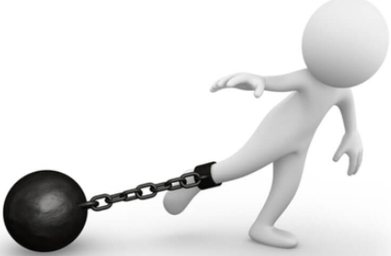
Project Goals
Objectives
Constraints
To predict Relapse Cases in Triple Negative Breast Cancer.
Data is very less for the prediction
Data is unbalanced

Slide 4
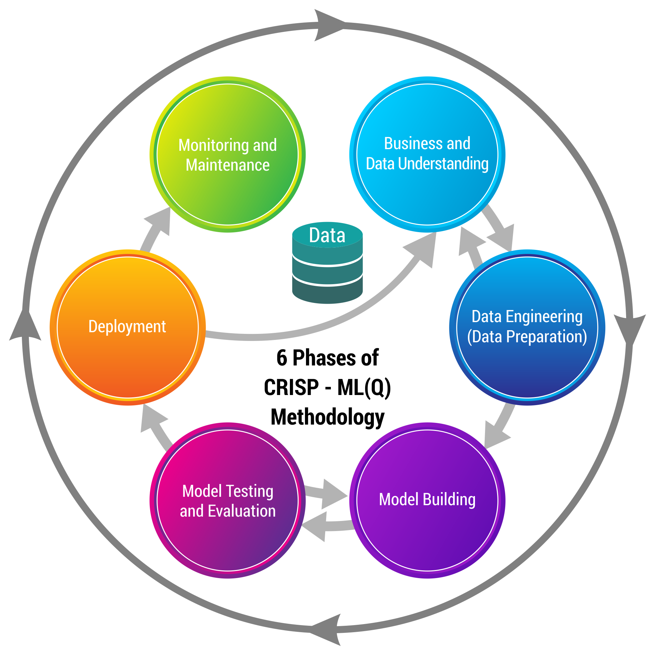
Business pipeline: CRISP-ML(Q) Methodology

Slide 5






List out all the Software, tools and environments used by you.

Slide 6
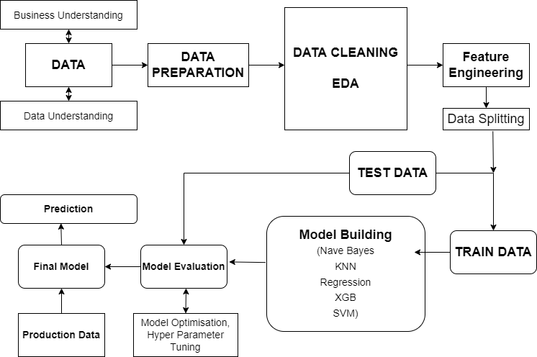
Project Architecture / Data Pipeline

Slide 7
Data Dictionary
Data Dictionary is given in a separate excel sheet
Data Dictionary.xlsx

Slide 8
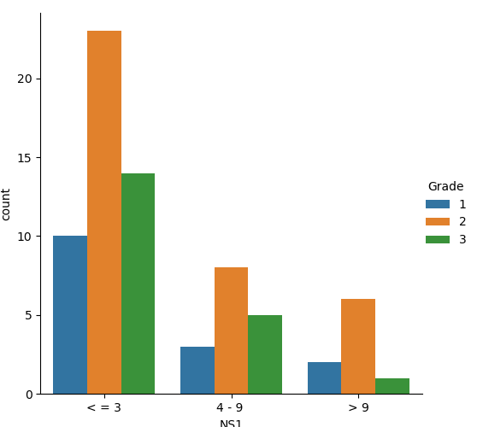
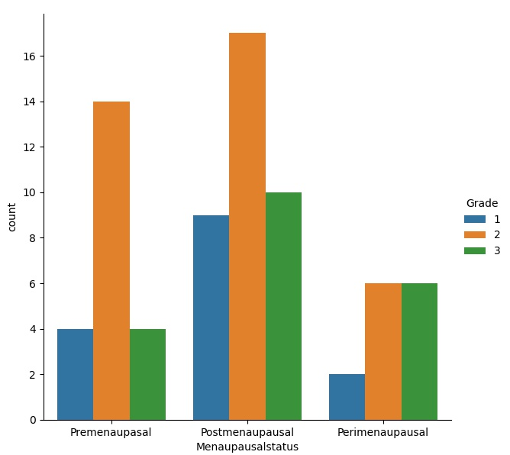
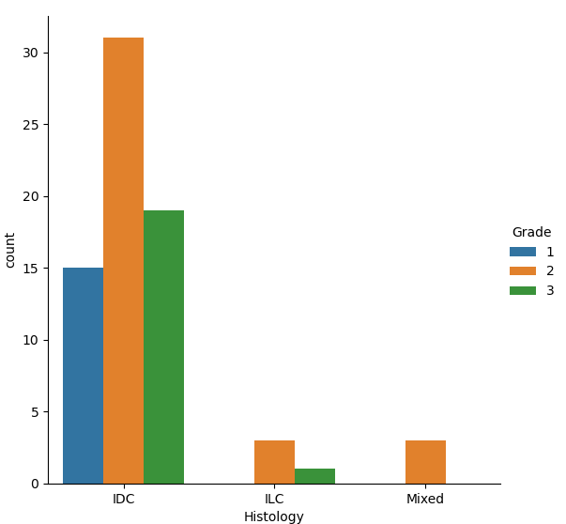
EDA
Grade of the TNBC referes to the type of cancer cell.The grade 3 means it can grow rapidly and grade 1 are normal celss.So we can plot based on the grade of cancer cells

Slide 9
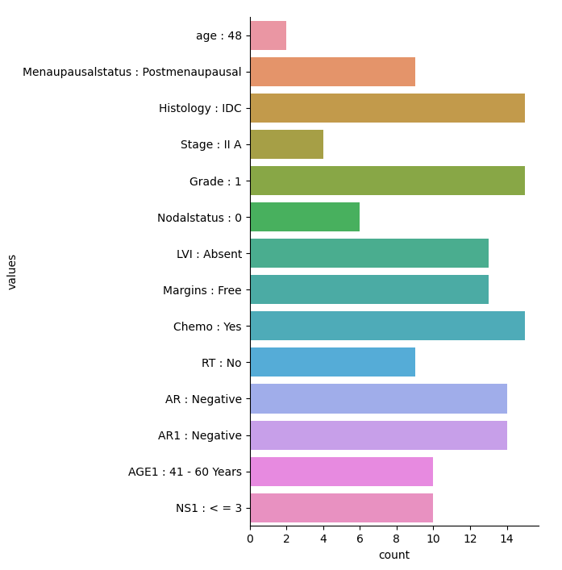
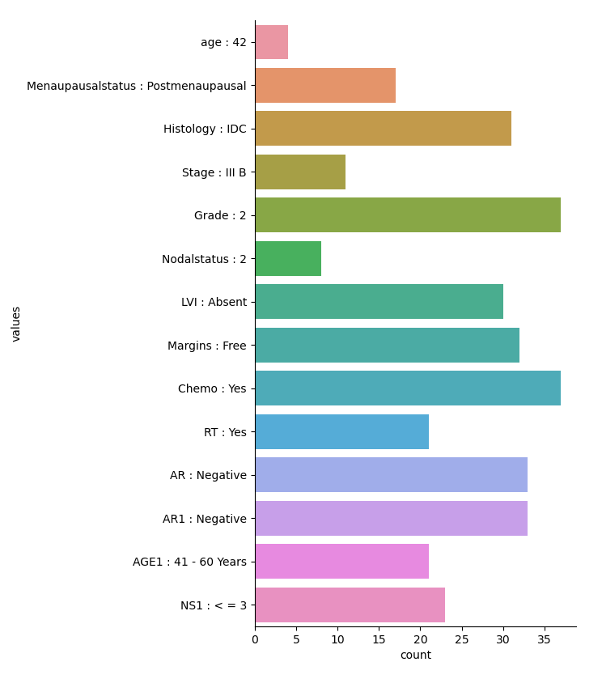
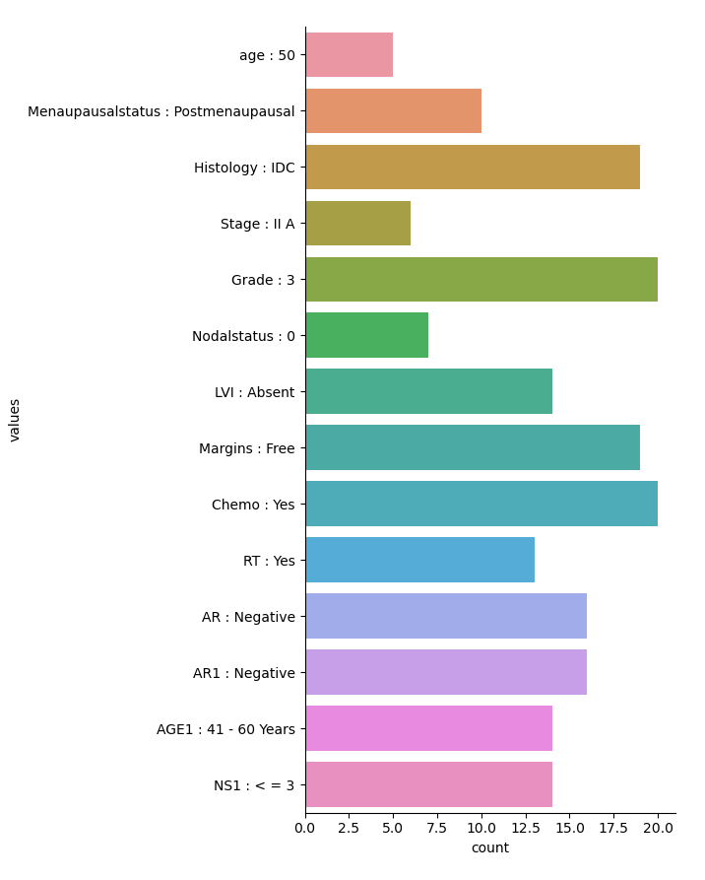
EDA
Grade 1
Grade 2
Grade 3
Here the menaupausalstatus is postmenaupaul for all of the grade.
Most of the cases are from the age group of 41-60 years
Histology IDC is most prominent for all the grades
Nodal status is also less than 3 for all the grades.

Slide 10
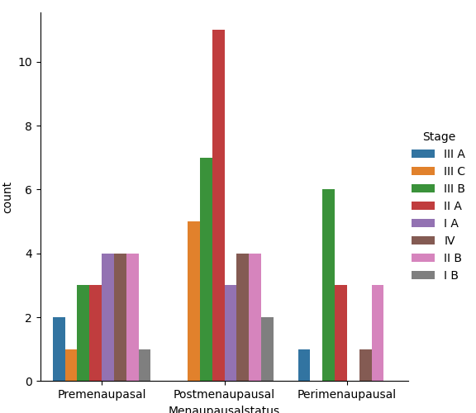
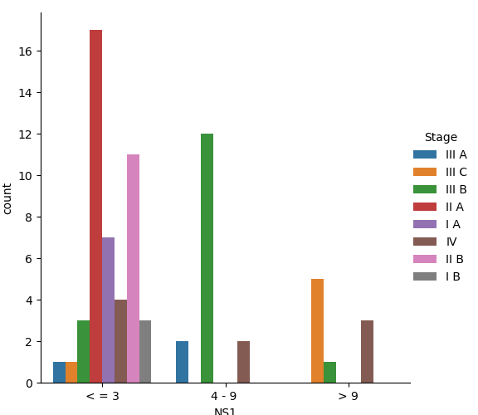
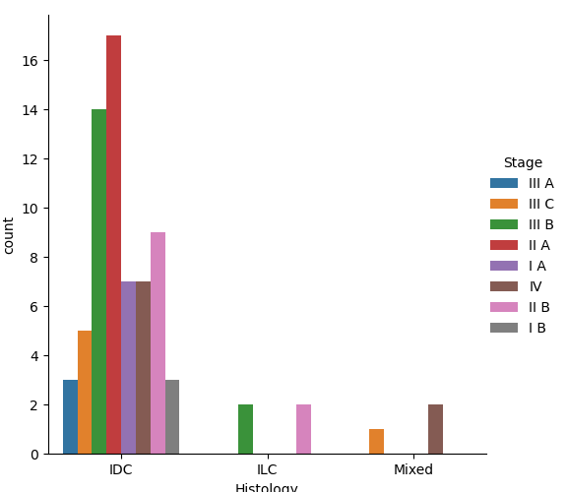
EDA
Stages of cancer are most vital in survival of the patient.Here there are five stages of cancer.5 refers to the most dangerous and 1 is the least.
Stage IIA is most prominent in postmenaupauls patients, Histology:IDC and Nodal Status less than 3
Nodal status from the range of 4-9 only have cancer above stage III
Histology IDC is most common for all stages of cancer
Nodal status less than 3 is most common for all stages
Mixed Histology is accounted only for higher stages of cancer

Slide 11
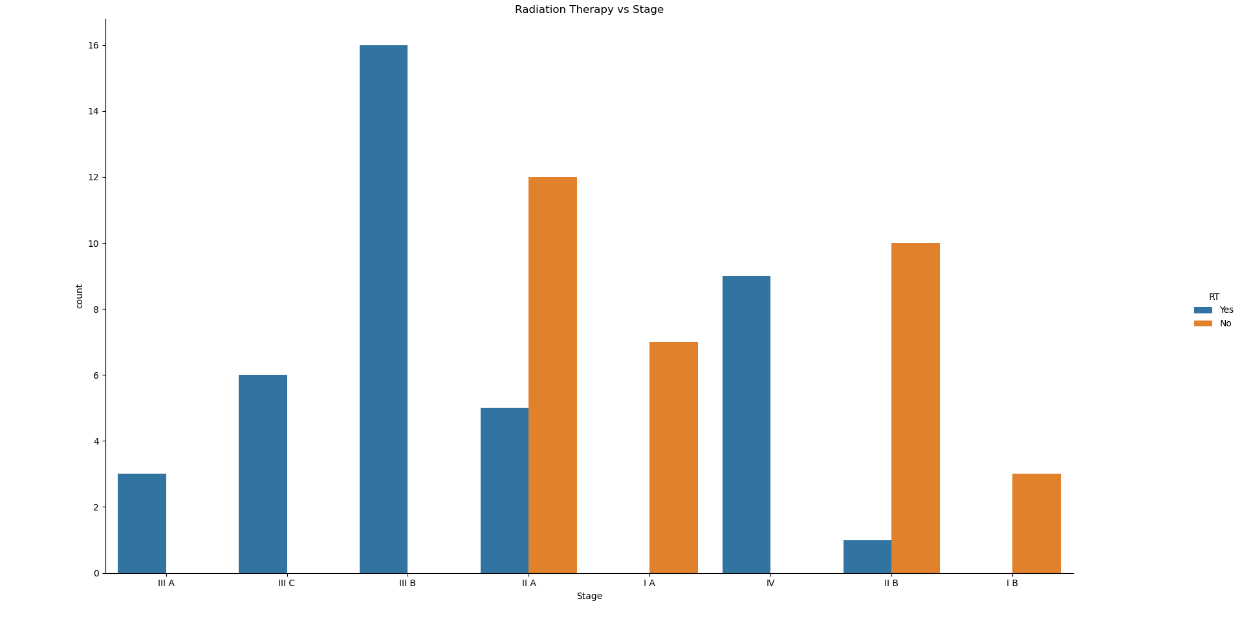
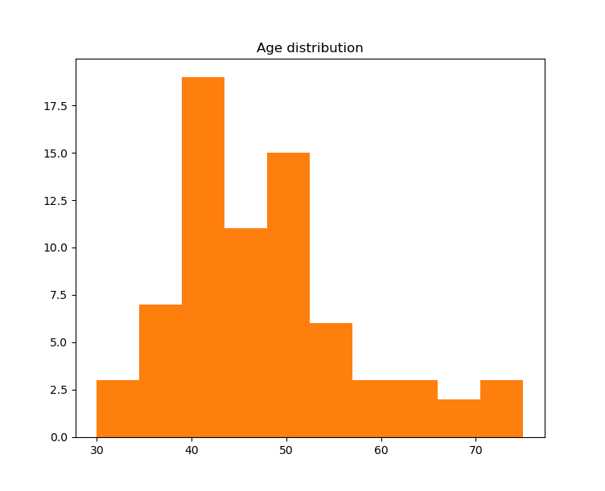
EDA
Radiation therapy is commonly given to thw patients have higher stages of cancer.
There is no RT given for patients less than grade 3 cancer.
The most common age of patients are from the range of 40 - 50 years

Slide 12
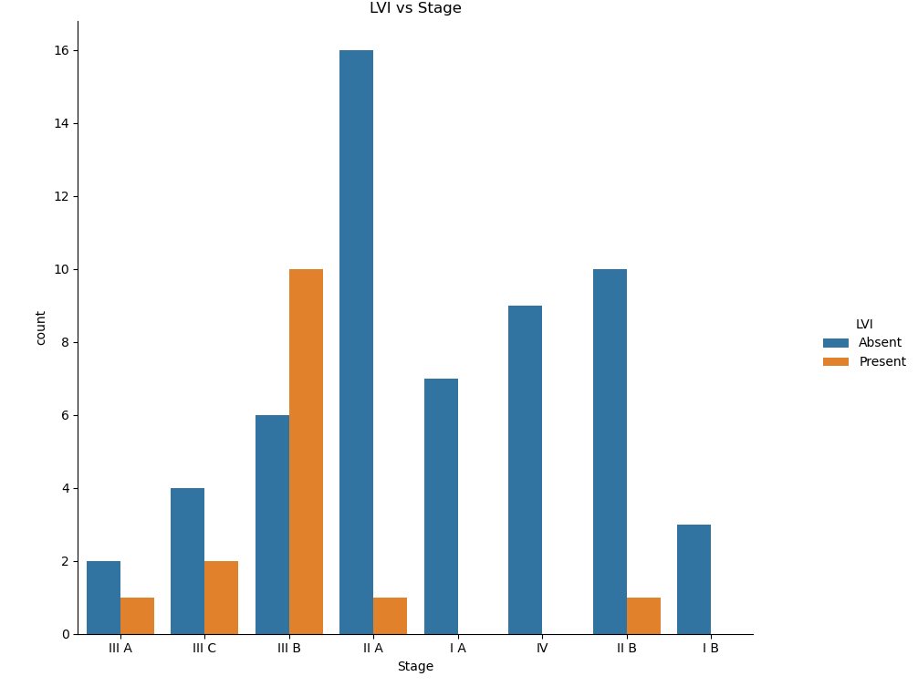
EDA
Lymphovascular invasion (LVI) has been a predictor of worse survival outcomes in breast cancer. Lymphovascular invasion (LVI) has been a predictor of worse survival outcomes in breast cancer. The combination of higher stage and presence of LVI accounts for least survival outcome.
There is no presence of LVI in intial stages of cancer.
More LVI are present in stage IIIB cancer.
Most of the cases above stage III have LVI Present in it
The patients present in the right side of the graph are having leeast survival outcome.

Slide 13
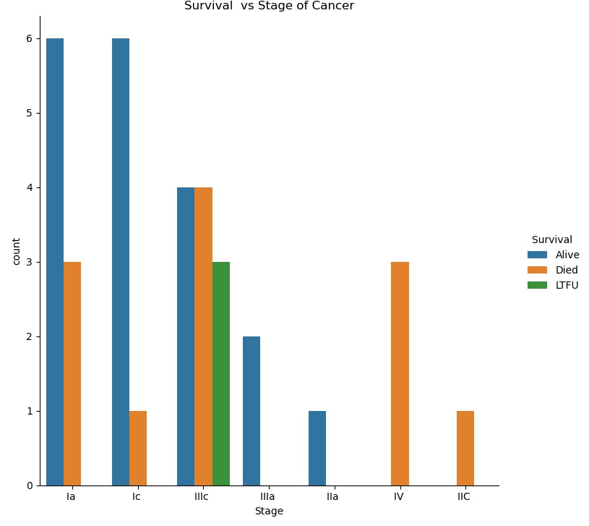
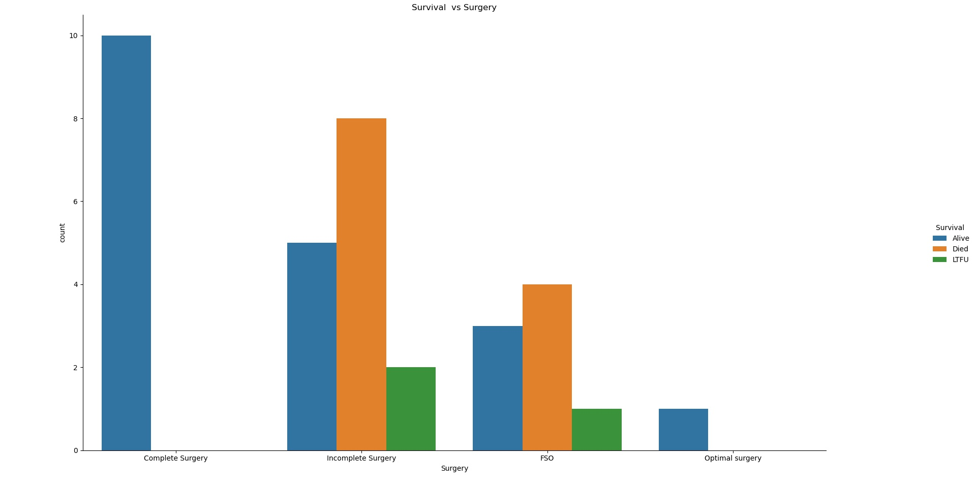
EDA on survival
Survival is least possible for the patients having cancer III and IV
The patients who had undergone complete and optimal surgery are survived
The patients who had undergone incomplete surgery are having less chance of survival
Patients under stage II Cancer are having high chance of survival

Slide 14
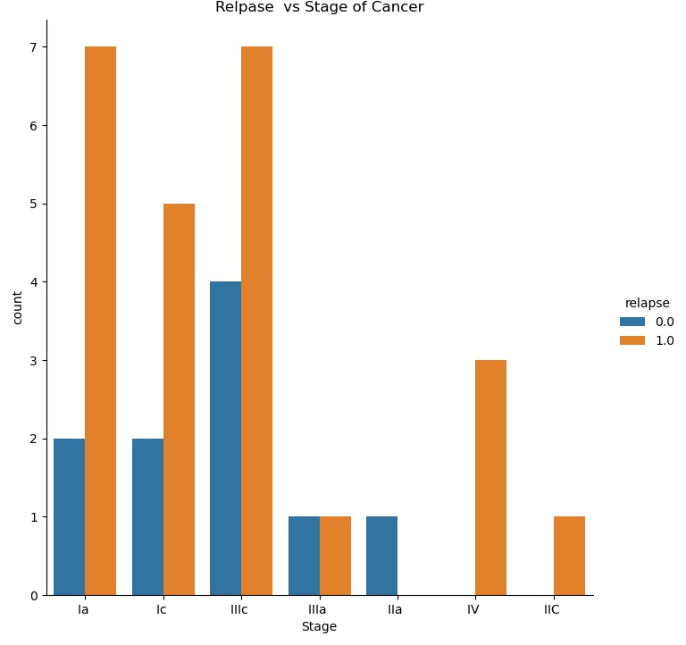
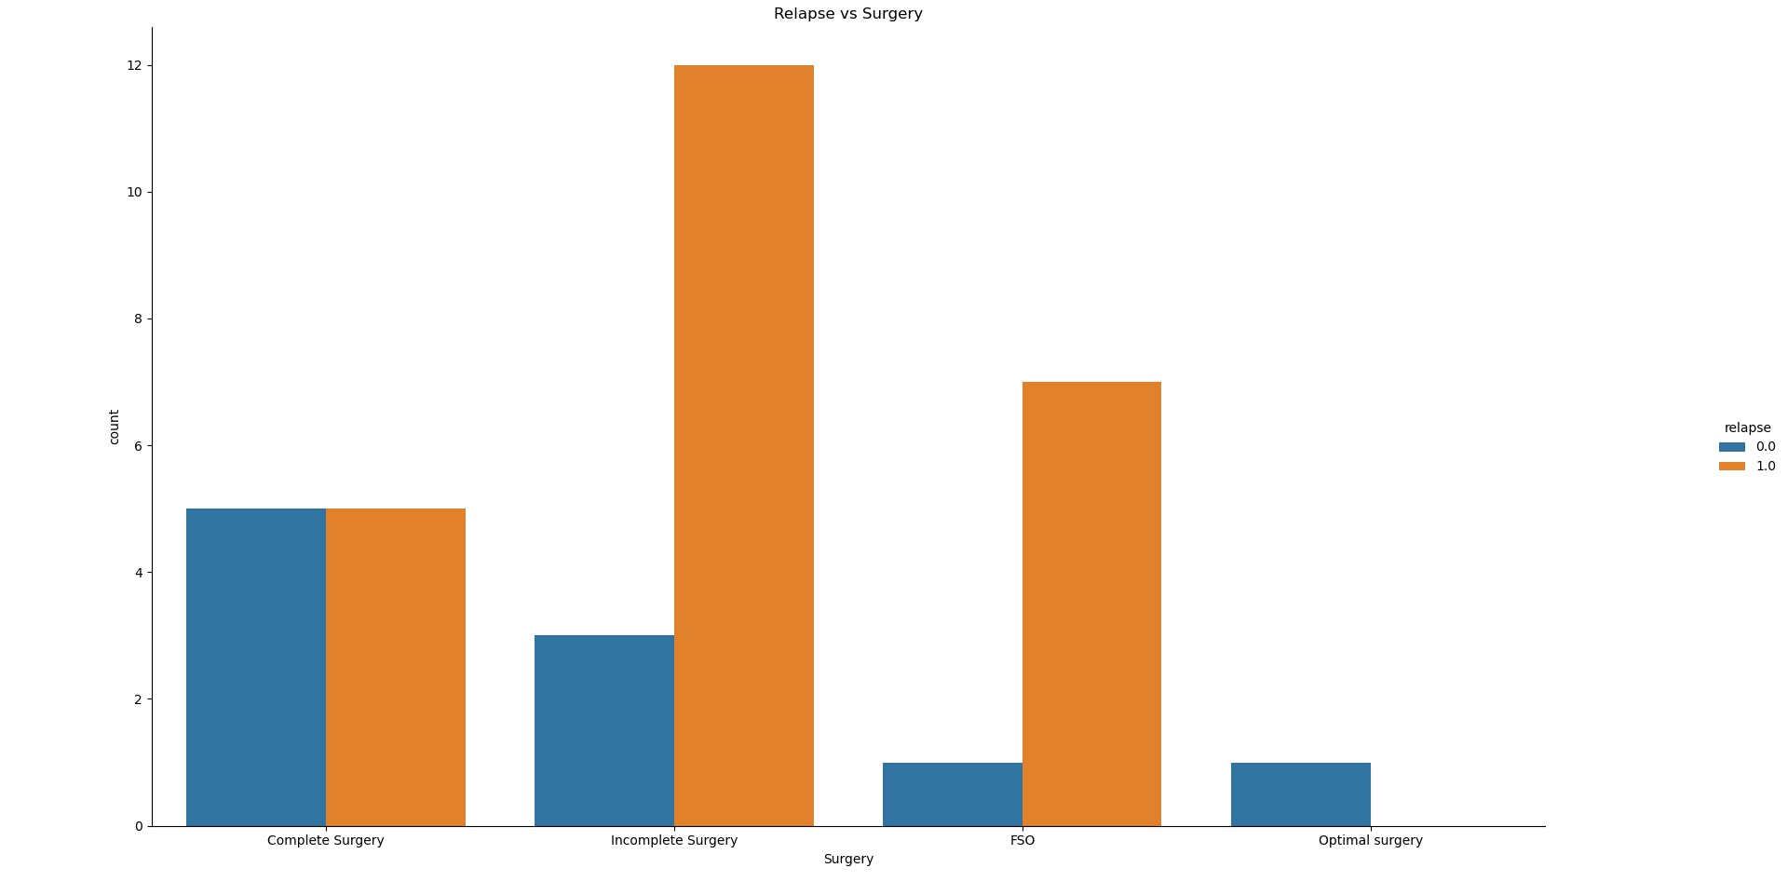
EDA on Relapse
All cases in the stage 4 cancer are relapse cases.
As the stages of cancer increases the relapse rate also increases. Almost all cases in the higher stages of cancer are relapsed
Chances of relpase in the icomplete surgery are higher than complete surgery.
Complete surgery and optimal surgery gives good result on non relpase category.

Slide 15
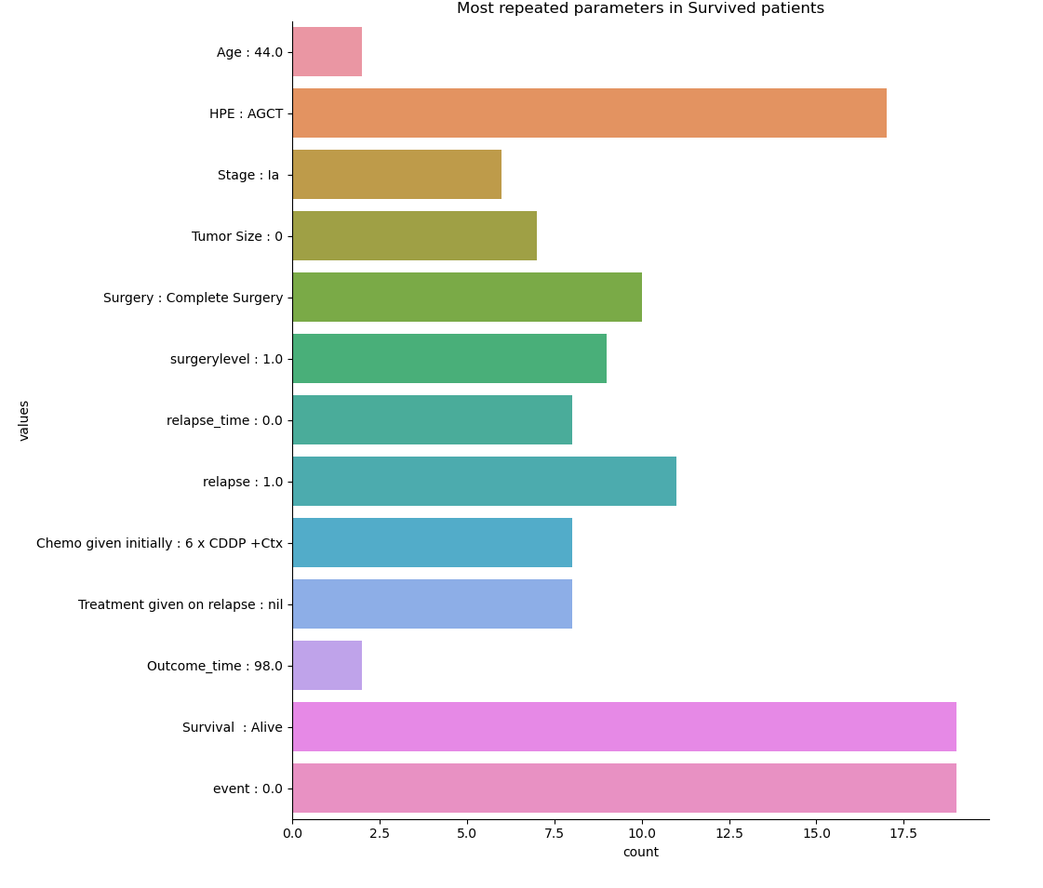
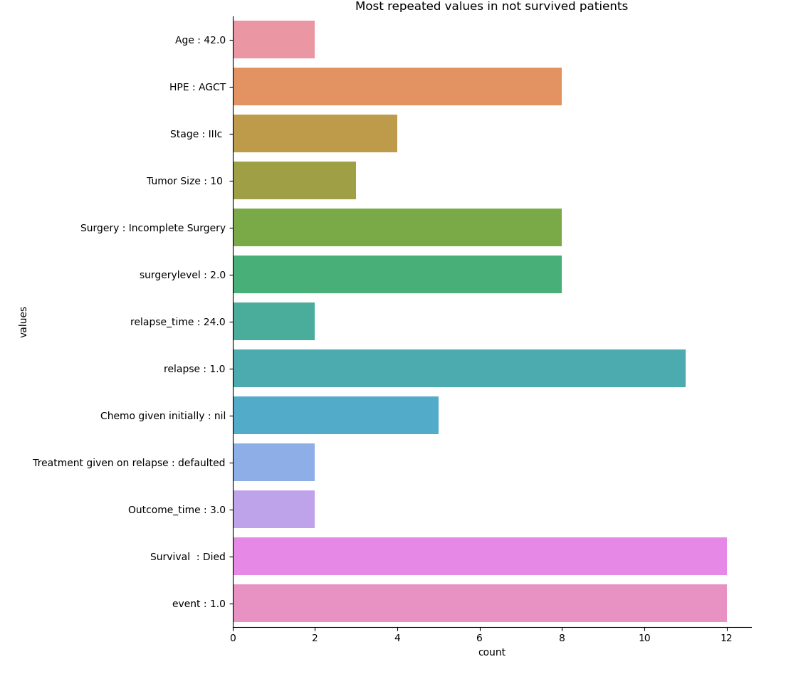
EDA survival:
The above graph shows the most occured values survived and non survived patients.

Slide 16
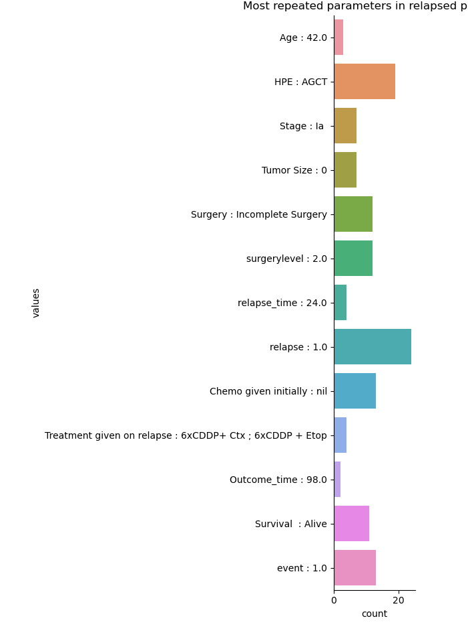
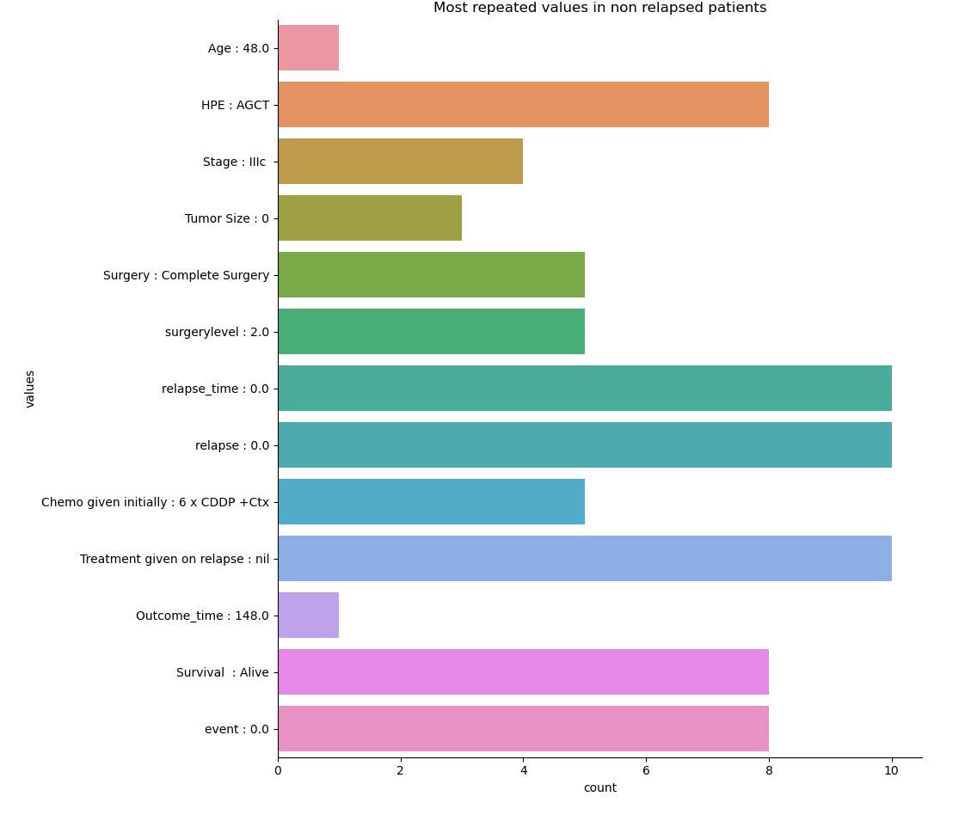
EDA : The above graph shows the most occured values relapsed and non relapsed patients
Here we can see that the intial treatment is not given for most of the relapsed patients and most of the chemo given patients are in the non relapsed category.
Intial chemo can be effective in preventing re occurence

Slide 17
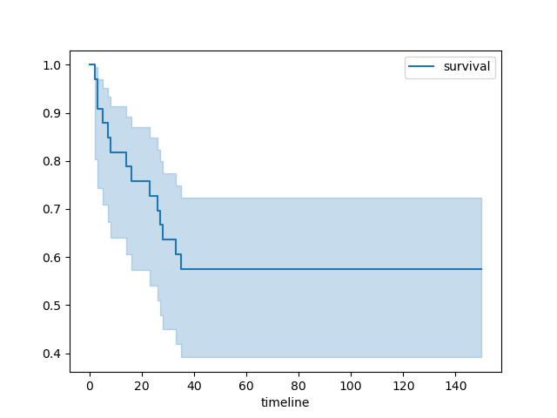
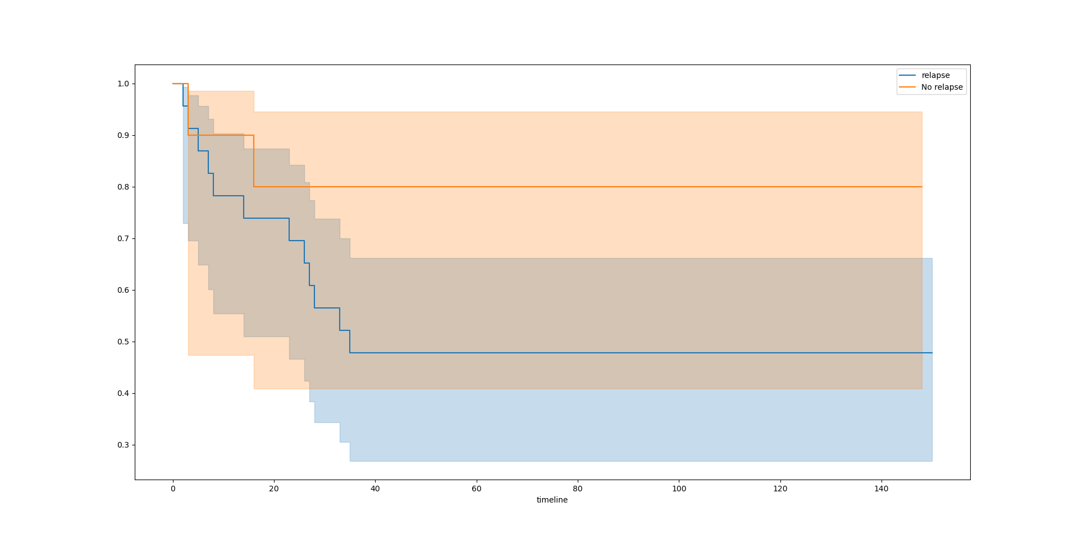
Survival Analysis
Survival rate of TNBC is not very viable. We can see a steep bend at the starting of curve
Survival rate of non relapsed patients high as compared to the relapsed patients

Slide 18

Data Preparation
And additional steps for data preparation
The ‘chemo given intially ‘ feature , unwanted white spaces are cleaned using lstrip and rstrip functions
The tumor size column is converted into float after removing unwanted expressions from the columns
Missing values in the tumor size are imputed as 0
Missing value in the outcome time is imputed using median imputing
Data is splitted in the ratio of 3:7 for test and train
Data set is highly unbalanced . So tried out some of the techniques like SMOTE.
One hot encoding is used for converting categorical to numerical value

Slide 19
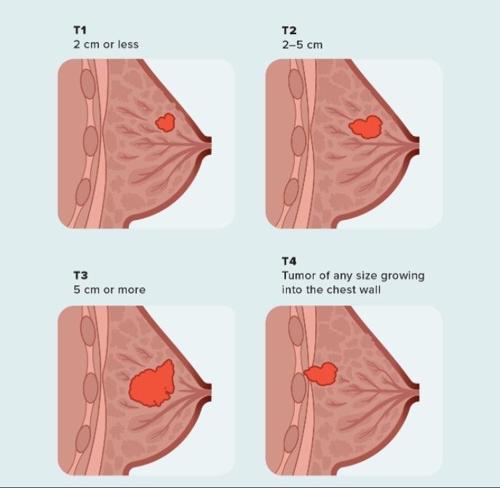
Tumor Size : Data Preparation
Here tumor size are given in different scales. Tumor length is defined as length of widest points in tumor.
Here some of the measurements are in area like 8*9, 11*10 etc.
Considering this as a area of rectangular shape. We can measure the widest point by calculating its diagonal.
Here i considered the area as a an area of rectangle and calculated its diagonal. Then replaced area with area diagonal length
eg:
area = 8*9
diagonal = sqrt(8*8 + 9*9)
length = 12.2

Slide 20

Model Building

Slide 21
Model Description
Algorithms used:
KNN - Plotted K values and accuracy for best k value
Naive Bayes
Logistic regression
Random Forest - n value = 8, max depth = 3
XGB with grid search CV

Slide 22
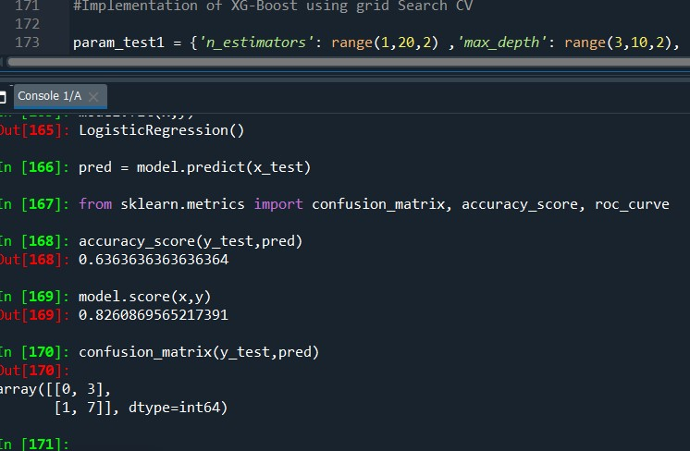
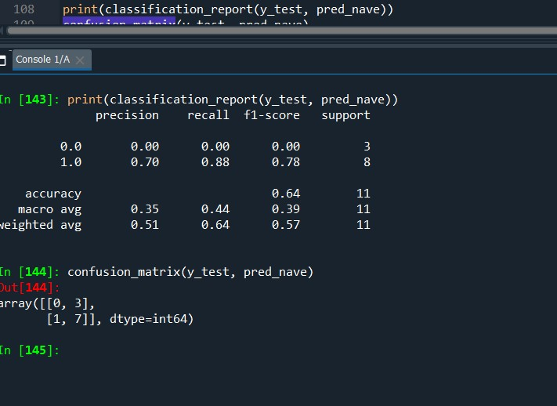
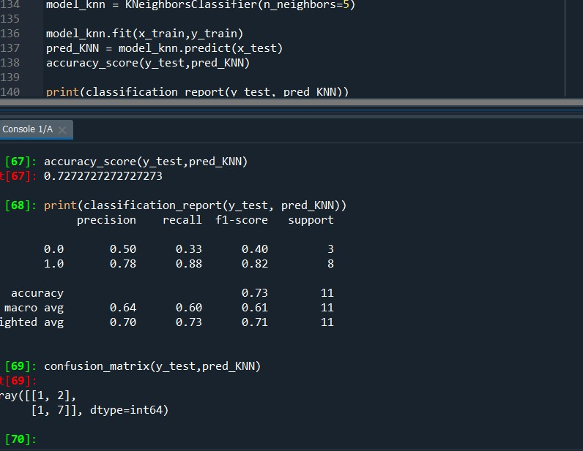
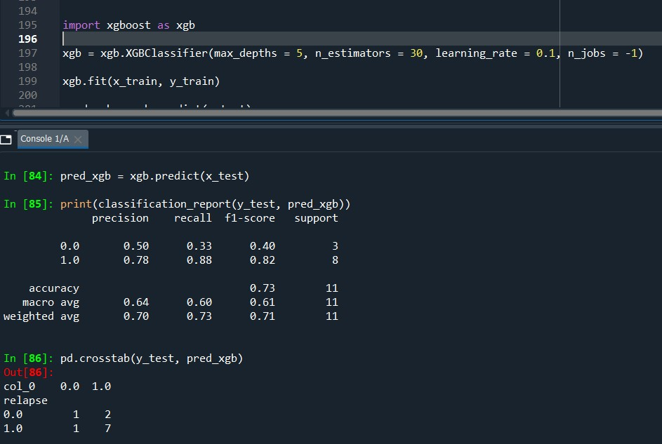
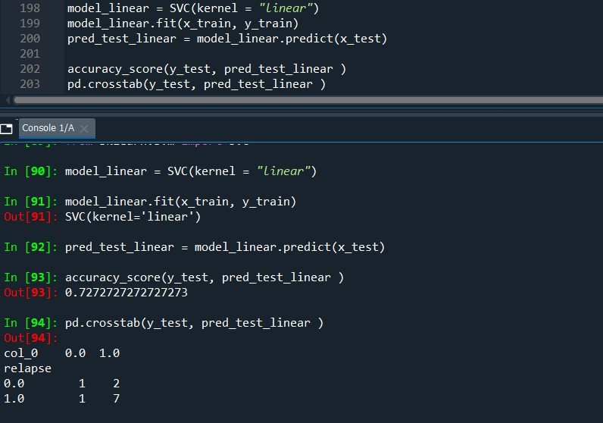
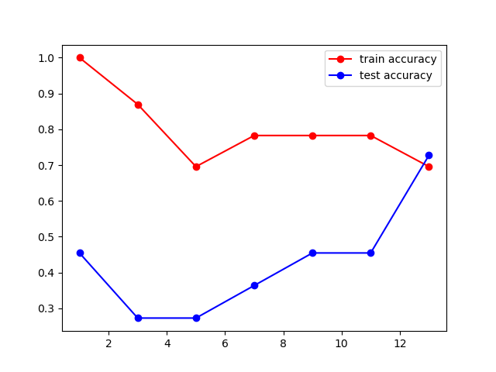
Outputs of the Model in Codes

Slide 23
Comparison of Model Performance
Models | Naive bayes | KNN | Logistic Regression | SVM | XGB
Accuracy | 65% | 72% | 68% | 72% | 74%
Precision
Confusion Matrix | 0 , 3 1 , 7 | 1 ,2 0 , 8 | 0,3 1,7 | 1 , 2 1 , 7 | 2 , 1 0 , 8
Note: No model is giving sufficent accuracy.This is mainly due to imbalanced data set.The false negative rate is very low for all models.
Tried imbalanced sampling techniques such as SMOT but the accuracy is not improving
Accuracy can be improved using label encoding but i dont think that is good choice to make.So i am sticking with onehot encoding

Slide 24

Deployment Strategy
Web Based deployment using Pywebio and Flask

Slide 25
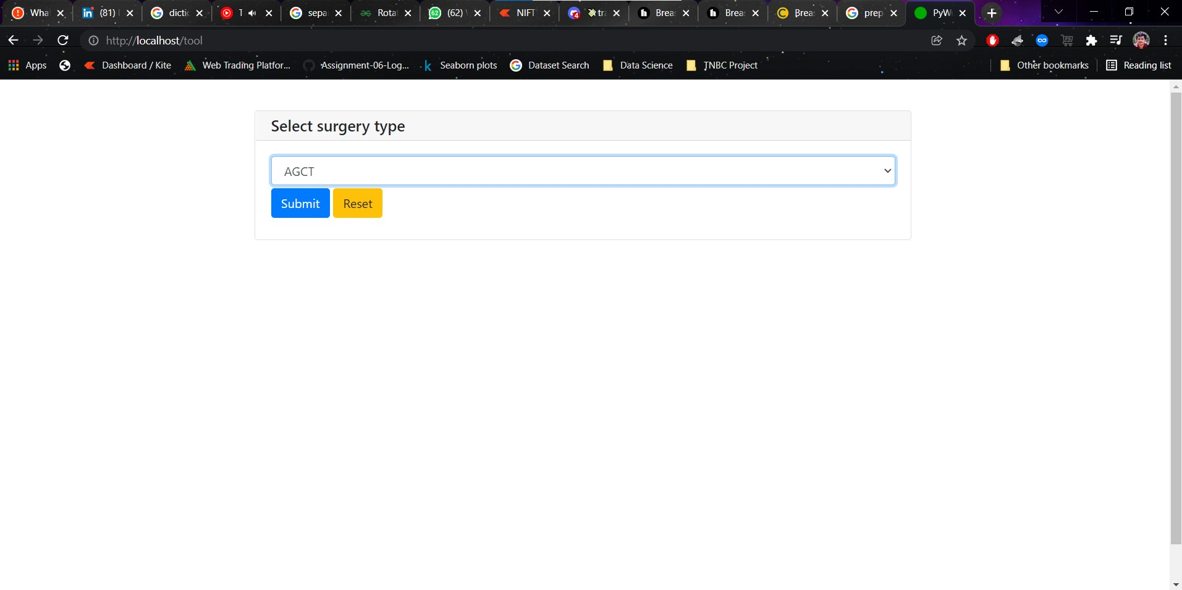

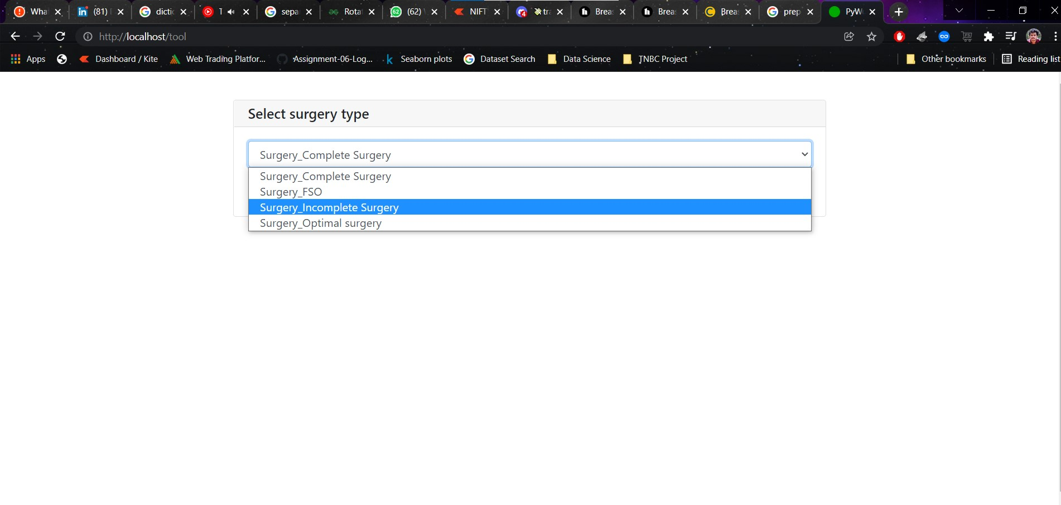
Outputs of the Deployed Model
OUTPUT
Outputs of
Universal Sentence Encoder:

Slide 26
Conclusion
Given two data sets are analysed and several valuable insights were made from it. The information from these insights can be used in the associated domain for various analysis.
The prediction model is created and deployed successfully.The performance of the model is good given that the data is very small and unbalanced.

Slide 27
Future Scope
The model can be used in the medical industry to predict the chances of relapse in TNBC cancer.It will help the help professionals to filter these kind of patients and to monitor them.
The model can be further improved by collecting more data.In that way the accuracy of the model can be improved and it will help to reduce the relapse cases in TNBC Patients.

Slide 28


